Slide 1
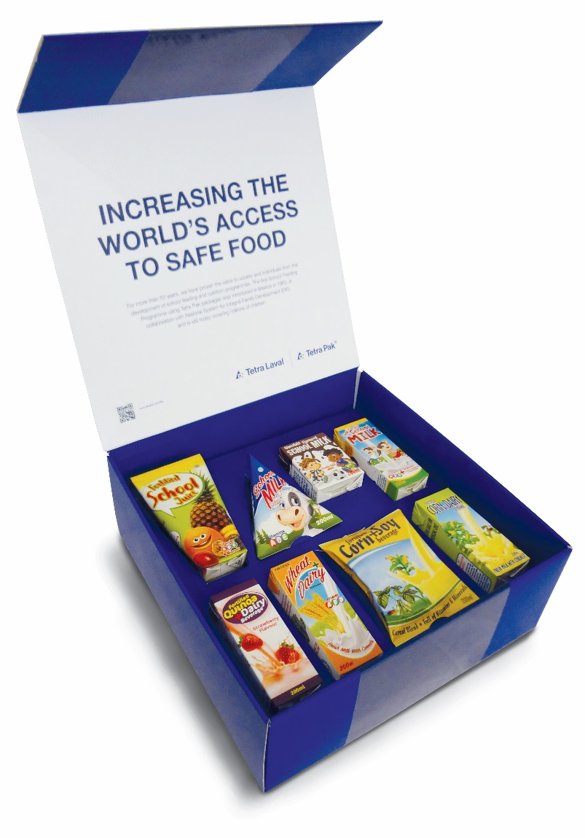
School Feeding Product Sample Kit
Food for Development

Slide 2
School Feeding Product Sample Kit
Box displaying eight package samples of different school feeding products
Inspired by actual products but with generic decor designs made by Food for Development
Display ingredients
To be used as a sales and promotion tool when meeting stakeholders and partners such as governments, customers and NGOs

Slide 3
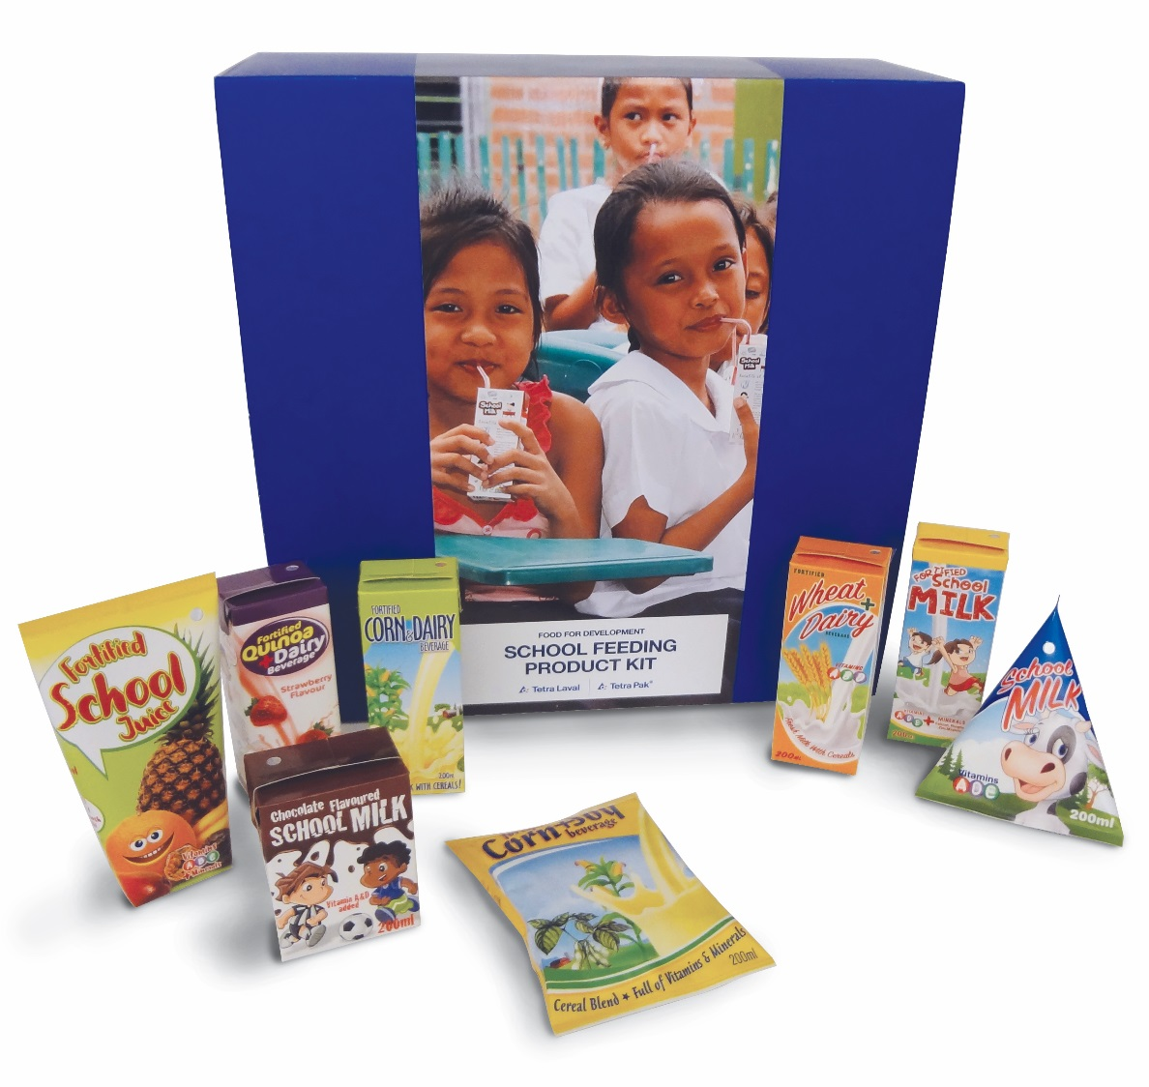
School Feeding Product Sample Kit

Slide 4
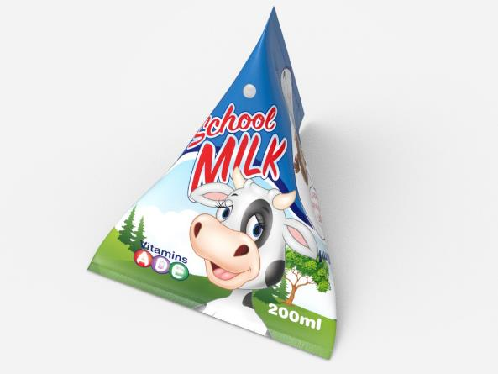
White Milk
Product: white milk
Package: TCA 200 B with white u straw
Decor includes fun fact

Slide 5
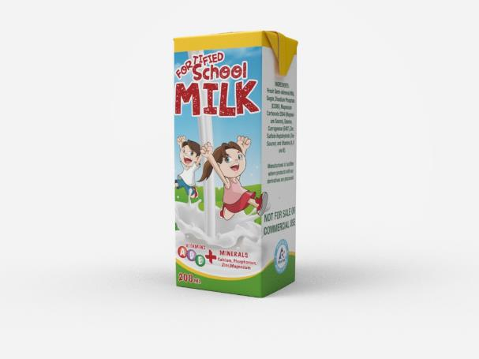
Fortified Milk
Product: fortified milk
Package: TBA 200 S with white u straw
Decor includes list of ingredients and fun facts

Slide 6
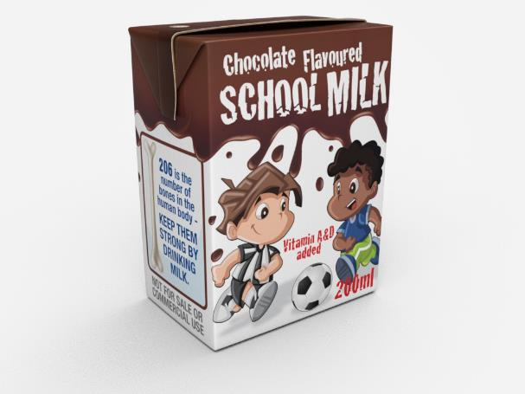
Flavoured Milk
Product: flavoured milk
Package: TBA 200 B with white straight straw
Decor includes list of ingredients and fun facts

Slide 7
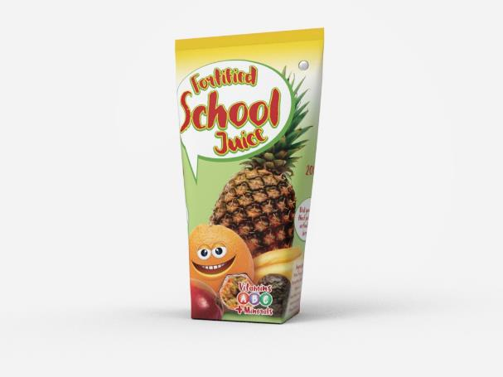
Fortified Nectar
Product: fortified nectar
Package: TWA 200 S with white u straw
Decor includes list of ingredients and fun facts

Slide 8
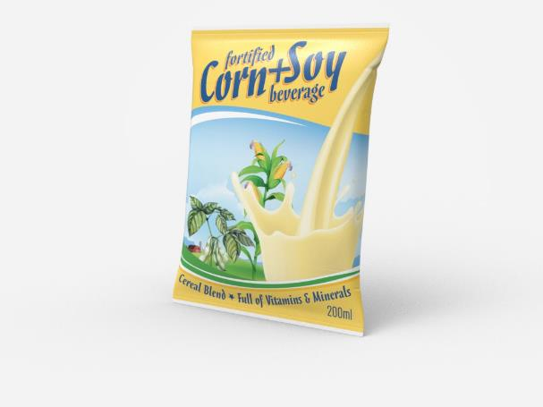
Fortified Corn Soy Beverage
Product: fortified corn soy beverage
Package: TFA 200 S with white u straw
Decor includes list of ingredients and fun facts
Inspired by Incaparina in Central America

Slide 9
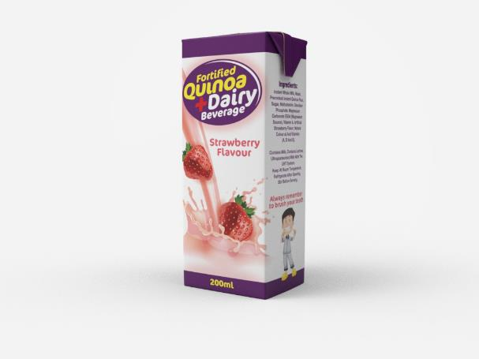
Fortified Quinoa Dairy Beverage
Product: fortified quinoa dairy beverage
Package: TBA 200 S with white u straw
Decor includes list of ingredients and fun facts
Inspired by Quinoa Milk in Ecuador

Slide 10
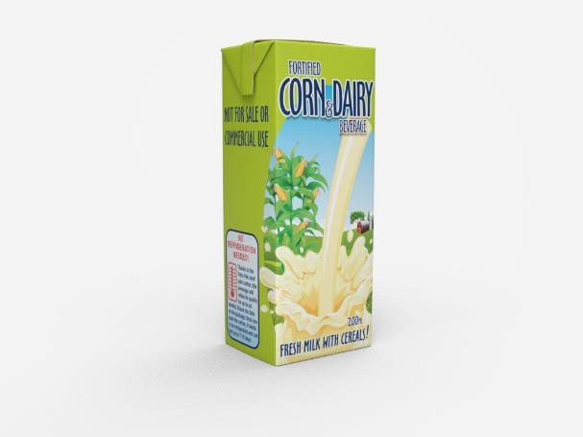
Fortified Corn Dairy Beverage
Product: fortified corn dairy beverage
Package: TBA 200 S with white u straw
Decor includes list of ingredients and fun facts
Inspired by Biestarina in Colombia

Slide 11
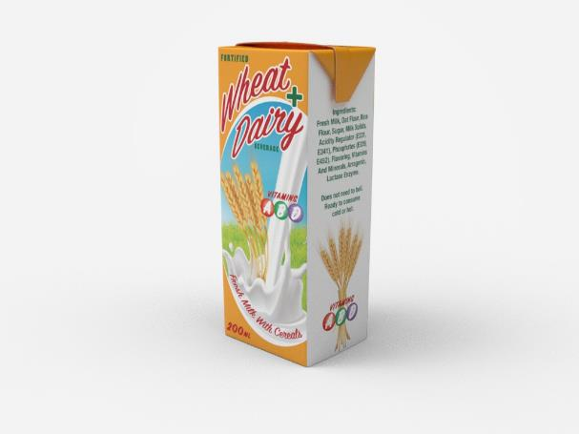
Fortified Wheat Dairy Beverage
Product: fortified wheat dairy beverage
Package: TBA 200 S with white u straw
Decor includes list of ingredients and fun facts
Inspired by Leche con Cereal & Yolait in Peru

